Slide 1
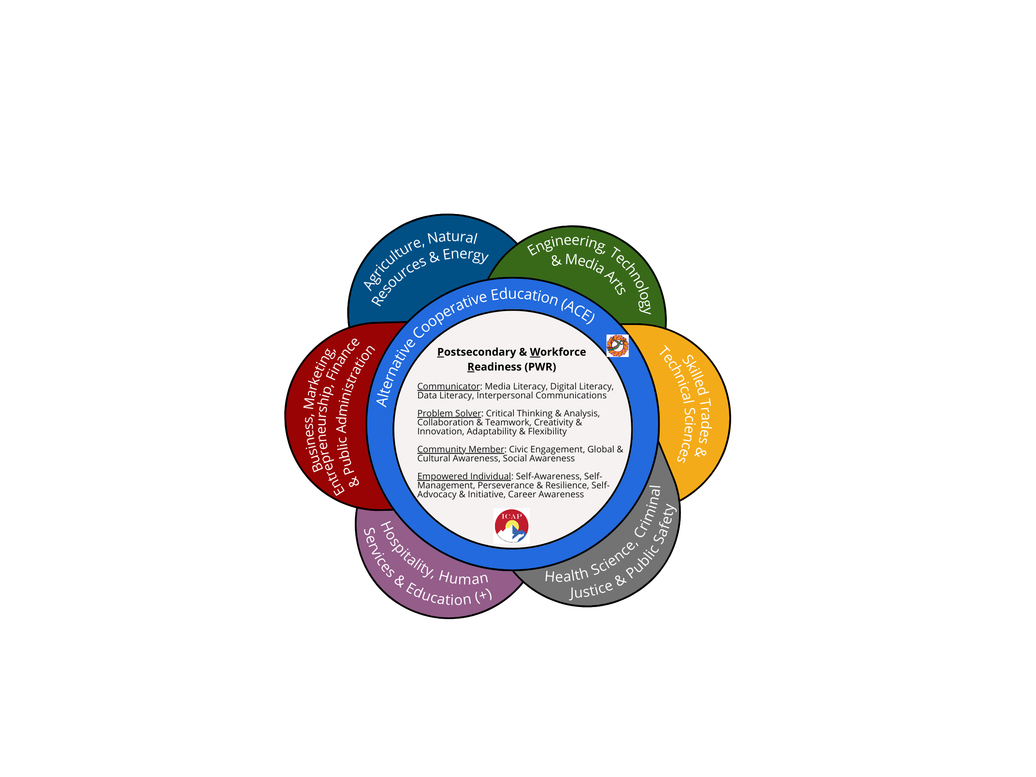
Colorado Career Cluster Model
updated December 2022
Agriculture, Food & Natural Resources
Animal Science* Agribusiness Systems
Food Products & Processing Systems* Natural Resource & Environmental Systems* Plant Science*
Power, Structural & Technical Systems*
*STEM affiliated pathway
Energy
Electromechanical Generation & Maintenance* Electrical Energy Transmission & Distribution* Energy Efficiency & Environmental Technology* Fossil Energy Extraction, Processing & Distribution*
Renewable Energy Production*
Engineering Technology Engineering Design* Electricity & Electronics* Applied Engineering* Principles & Design* Robotics & Automated Systems*
Computer Science* Computer Integrated Design & Manufacturing*
*STEM affiliated pathway
Media Arts
Design & Multimedia Arts* Graphic Design & Illustration* Animation*
Commercial Photography*
Digital Media & Communications* Audio Video Production*
Digital Design*
Online and Print Media* Production & Manager(s) Arts* Sound Engineering & Design* Stage Production Management* Set Design*
Computer & Digital Technologies
Coding*
Mobile App Development* Game Design*
Network Systems & Security* Web Design*
Web Development & Digital Communication*
Outdoor Recreational Leadership
Management and Administration
Administrative Services Business Information Technology Corporate/General Management
Human Resource Management
Operations Management
Manufacturing
Health, Safety & Environmental Assurance
Logistics & Inventory Control Manufacturing Production Maintenance, Installation & Repair Production/Process Technology* Quality Assurance
Architecture & Construction
Construction
Design & Pre-Construction* Maintenance & Operations
*STEM affiliated pathway
Government & Public Administration
Foreign Service Governance Legal services Planning
Public Management & Administration Regulation
Revenue & Taxation
Transportation, Distribution & Logistics
Facility & Mobile Equipment Maintenance
Health, Safety & Environmental Management
Logistics, Planning & Management Services
Planning, Management & Regulation
Sales & Service Transportation Operations Transportation/Systems Infrastructure
Warehousing & Distribution Center Operations
Marketing
Digital Marketing Marketing Communications Marketing Management Marketing Research Merchandising Professional Sales/Sales Management
Entrepreneurship
Finance
Accounting Banking Services Corporate Finance Insurance
Securities & Investments
Human Services
Consumer Services
Counseling & Mental Health Services Early Childhood Development Family & Community Services Personal Care Services
Social Work
Human Development & Family Studies
Health Science Biotechnology* Diagnostic Services* Pharmacy Technician* Medical/Clinical Assistant* Therapeutic Services Dental Assistant* Behavior Health
Emergency Medical Technician* Nurse Assistant/Aide*
Sports Medicine Personal Trainer OT/PT Assisting/Aide
Criminal Justice & Public Safety Emergency Management Services Law Enforcement Services
Fire Science
Security & Protective Services
Hospitality & Food Production
Lodging
Recreation, Amusements & Attractions
Restaurants, Food & Beverage Services
Travel & Tourism
Education & Training
Administration & Administrative Support Professional Support Services
Teaching & Training
+FACS Core & World of Work (WOW)
*STEM affiliated pathway

